Slide 1

Sprocket Central Pty Ltd
Data analytics approach

Slide 2
Agenda
Data Exploration
Model Development
Interpretation

Slide 3
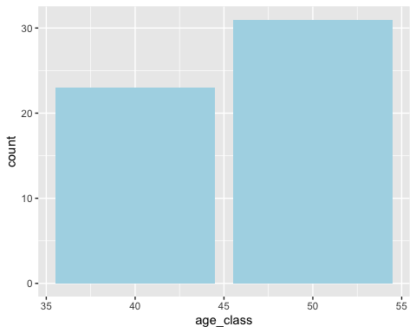
Data Exploration : Age Distribution for New Customer
New customers are from the age group of 45-55.
Place any supporting images, graphs, data or extra text here.

Slide 4
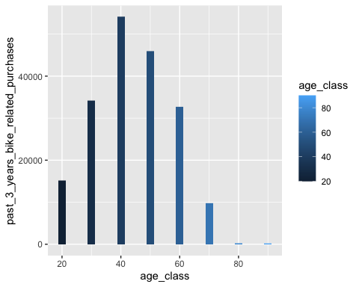
Data Exploration : Age Distribution w.r.t. Bike Purchases
Data shows age group 40-50 has high count in terms of bike purchased in last 3 years.
Place any supporting images, graphs, data or extra text here.

Slide 5
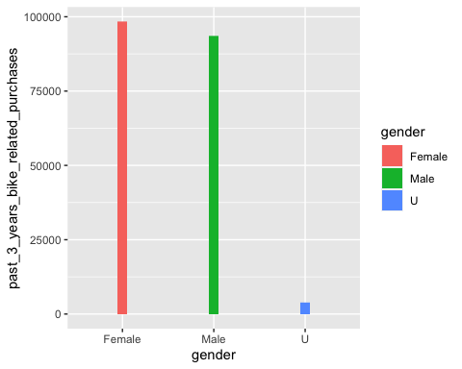
Data Exploration : Gender Distribution w.r.t. Bike Purchases
Data shows Female category has slightly high count in terms of bike purchased in last 3 years as compared with other genders.
The target audience for our marketing and advertising should be inclined to provide focus on females than males.
Place any supporting images, graphs, data or extra text here.

Slide 6
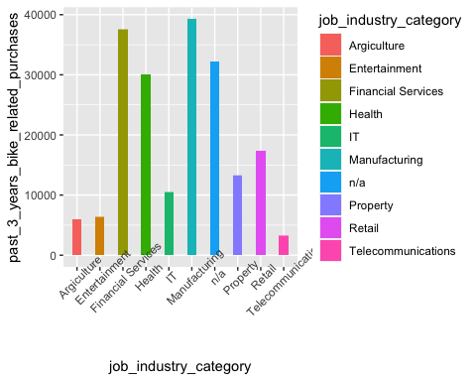
Data Exploration : Job Industry w.r.t. Bike Purchases
Manufacturing, Financial Services and Health are the top three profit-generating industries, followed by retail and property.
Place any supporting images, graphs, data or extra text here.

Slide 7
Model Development
RFM Analysis
RFM means recency, frequency and monetary, it measures how much one customer contributes to a business.
Recency tells when the most recent purchase of a particular customer was,
Frequency measures how frequently a customer buys from the business and
Monetary measures how much a customer spends at the business in total.

Slide 8
Model Development
RFM Score
rfm_table_order() takes 8 inputs:
data: a data set with
customer_id : name of the customer id column
transaction_date: name of the transaction date column
profit : name of the transaction amount column
analysis_date : date of analysis
recency_bins : number of rankings for recency score (default is 5)
frequency_bins : number of rankings for frequency score (default is 5)
monetary_bins : number of rankings for monetary score (default is 5)

Slide 9
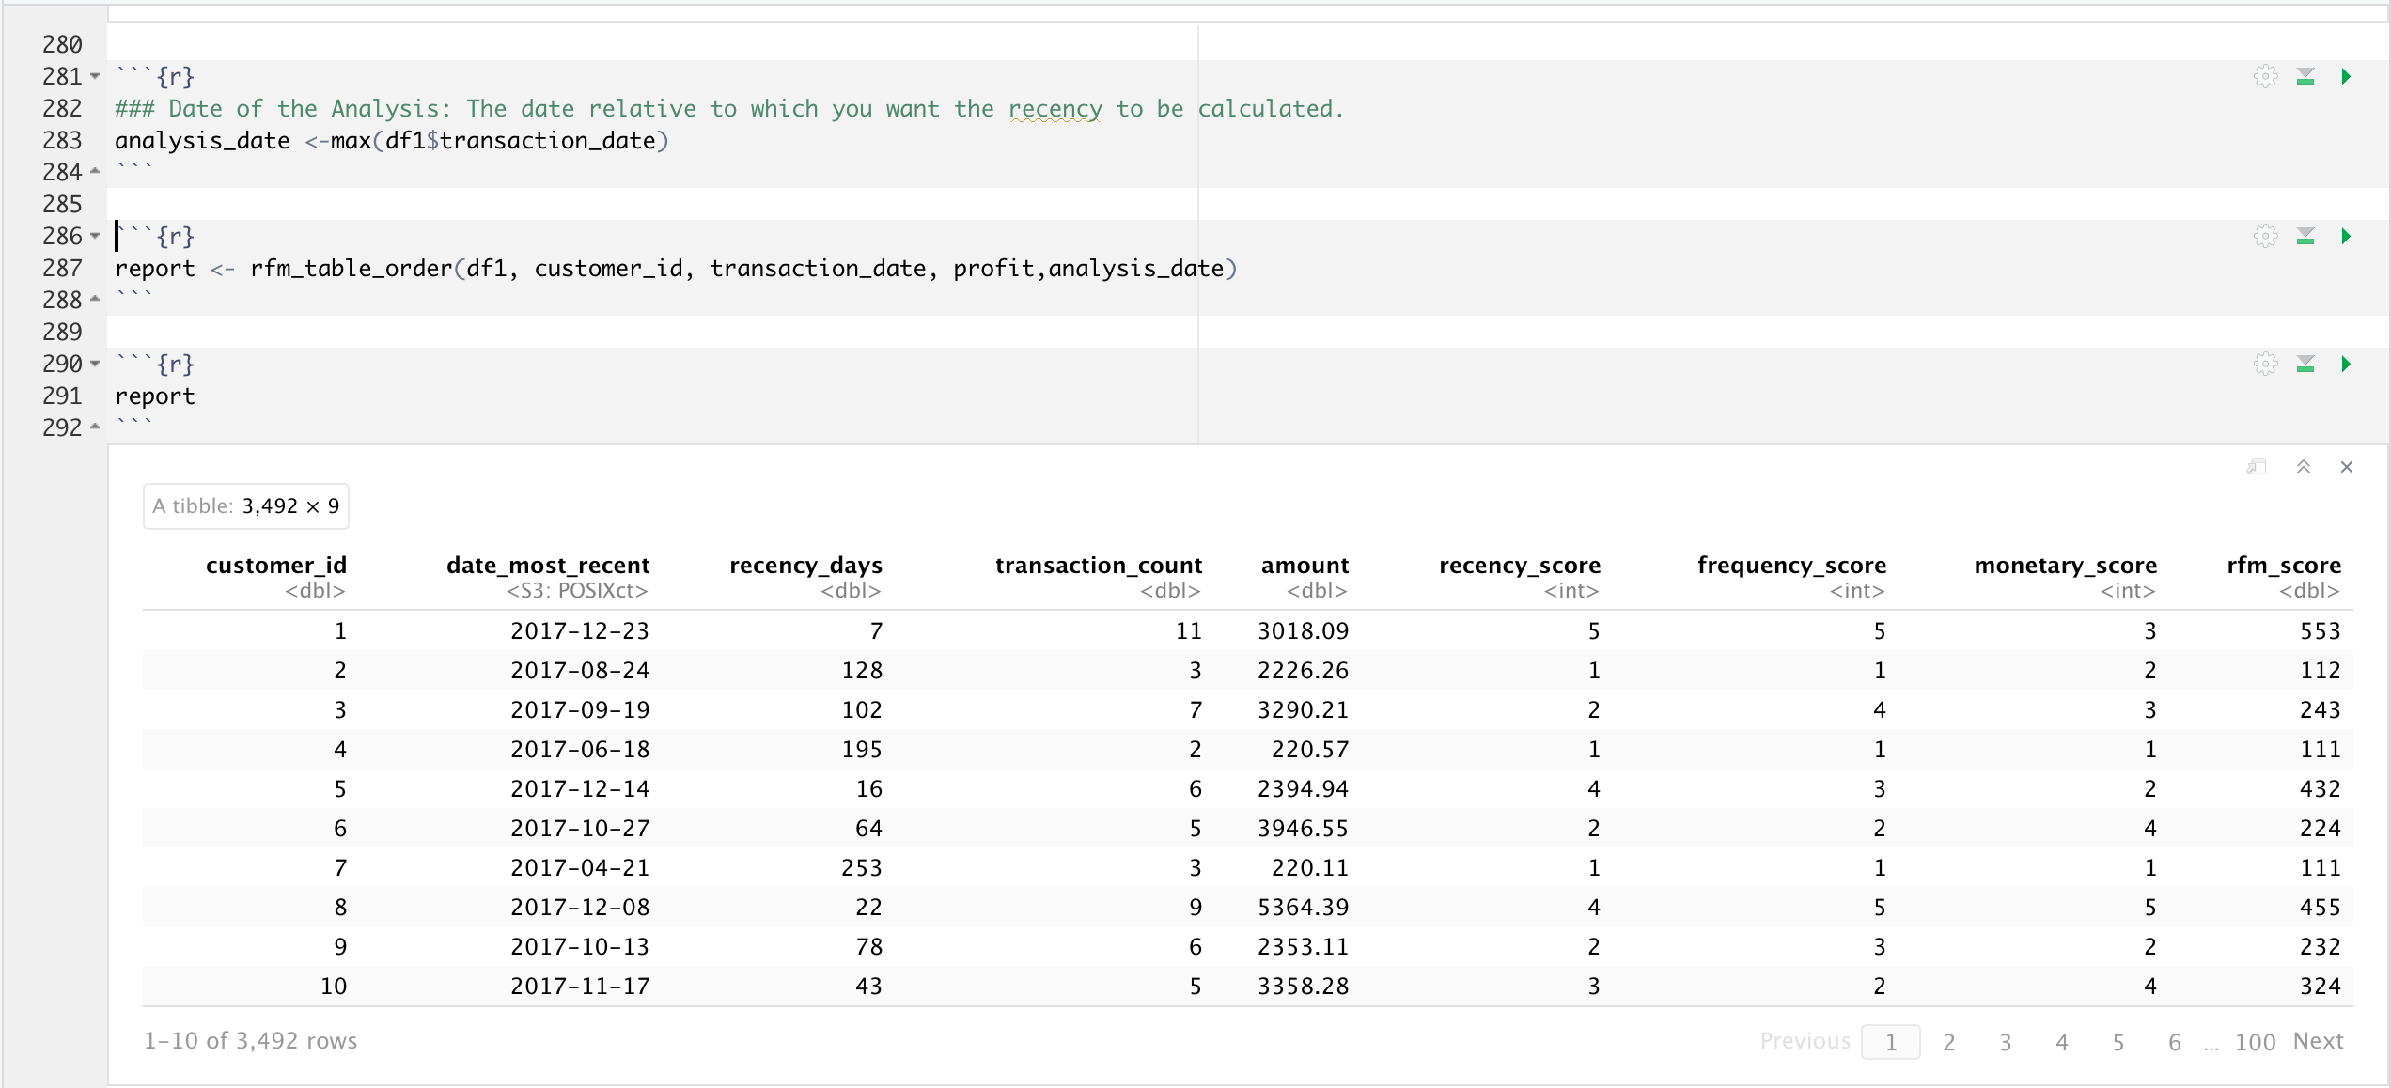
Model Development
RFM Score

Slide 10
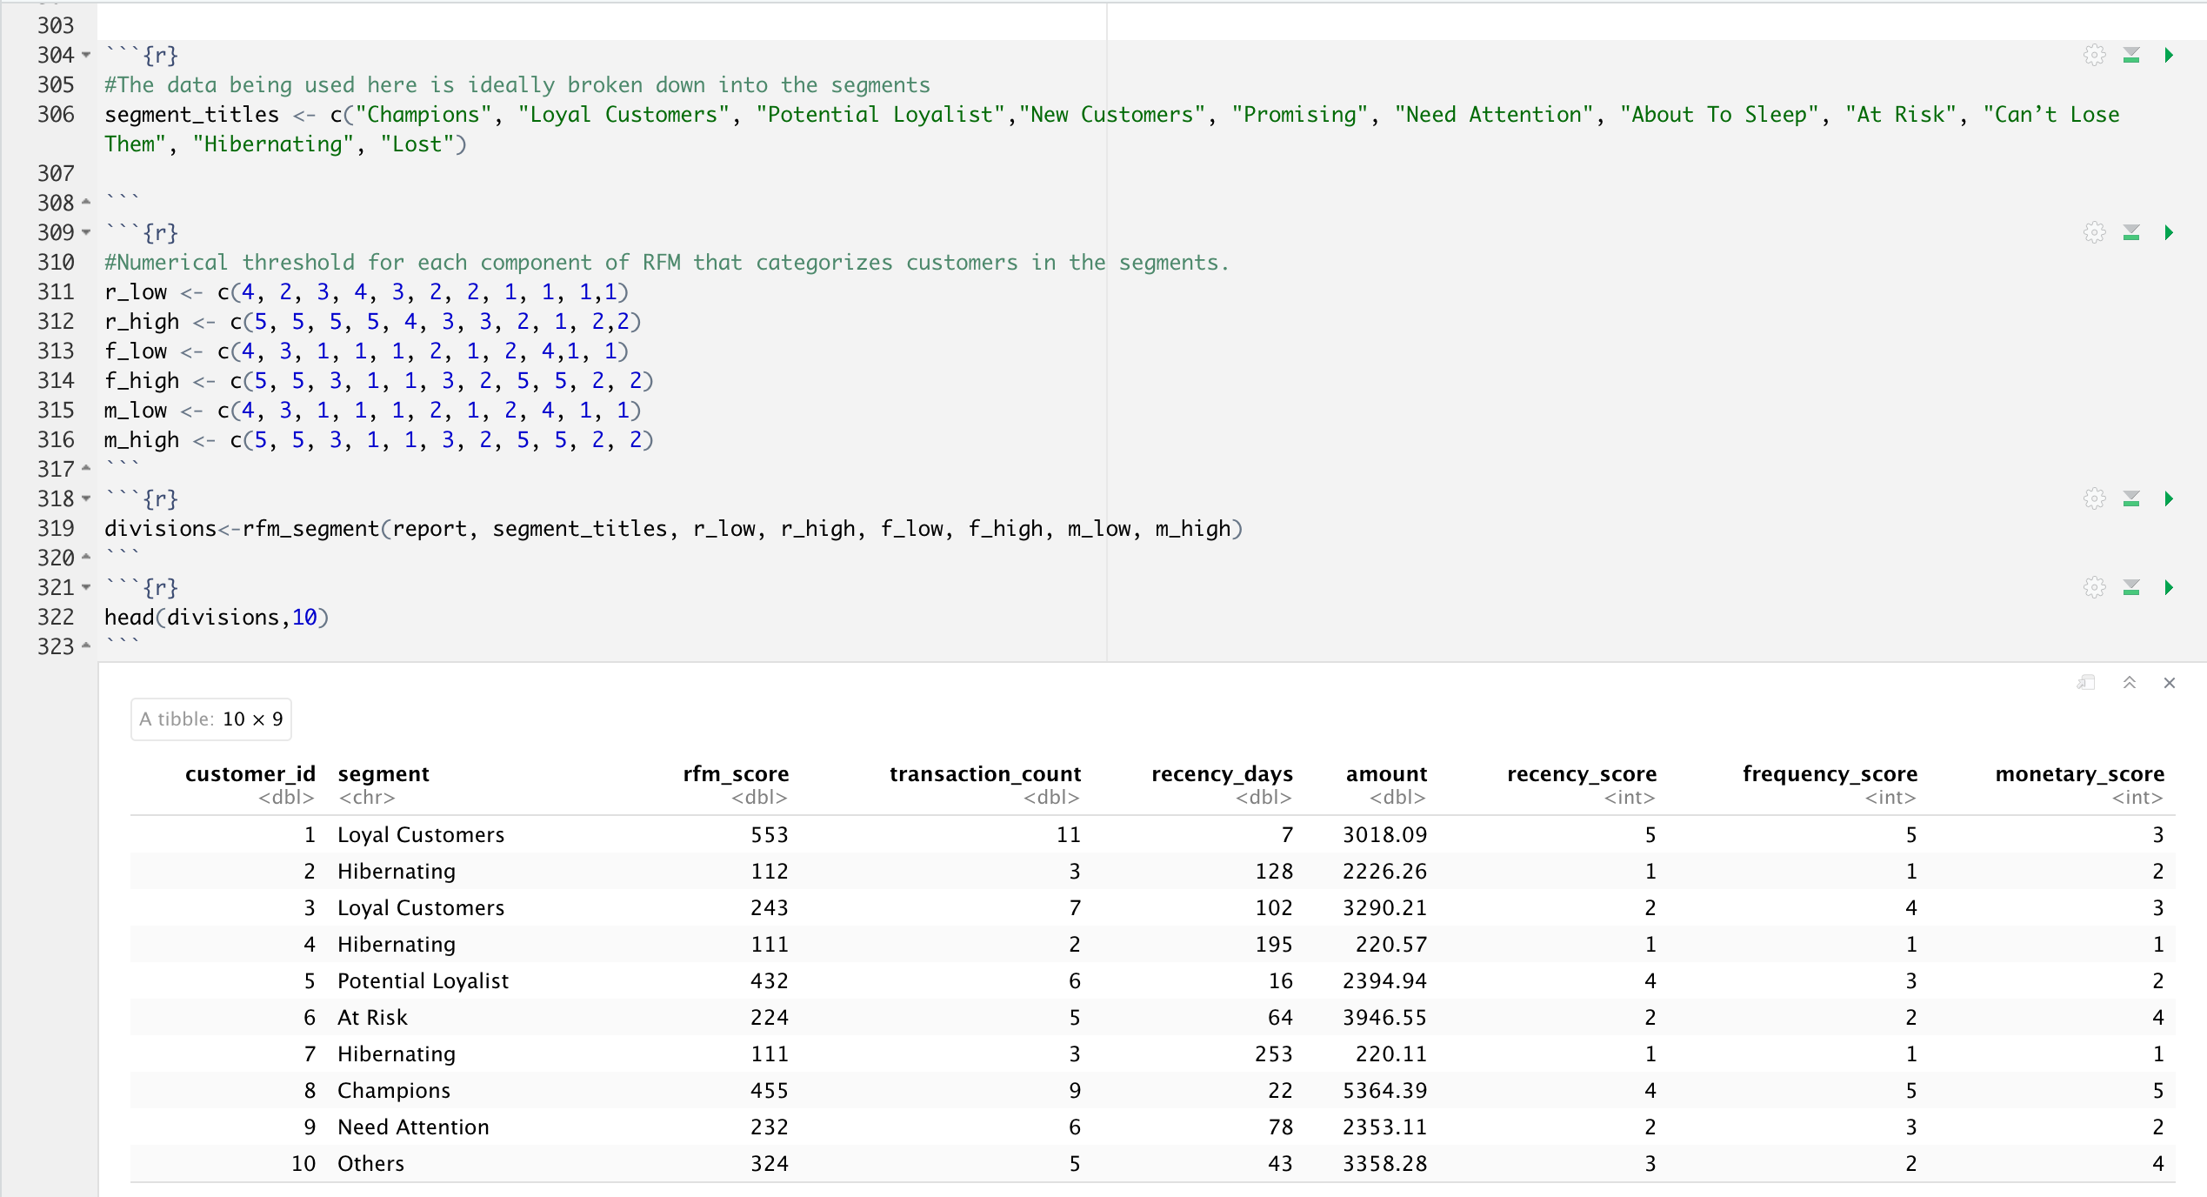
Model Development
Customer Segmentations

Slide 11
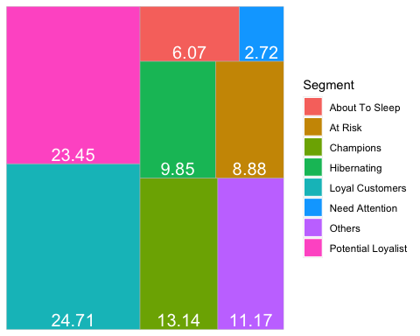
Model Development
Customer Segmentations
Distribution of customer segments in percentages

Slide 12
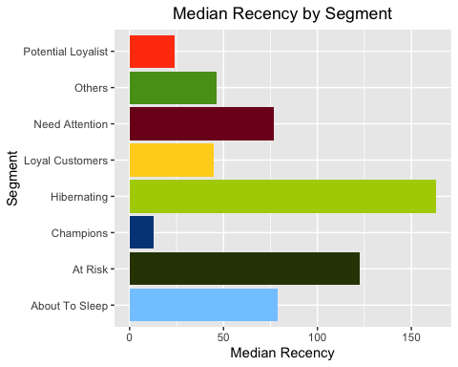
Model Development
Median Recency

Slide 13
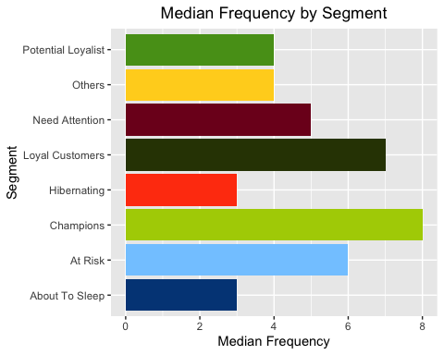
Model Development
Median Frequency

Slide 14
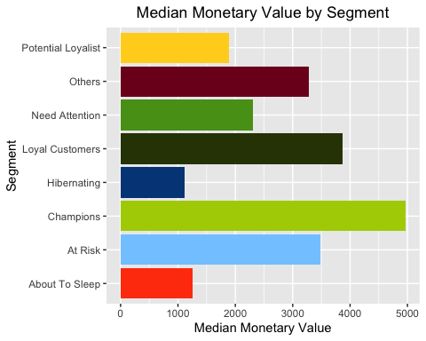
Model Development
Median Monetary Value

Slide 15
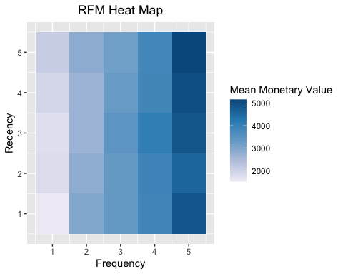
Model Development
Higher scores of frequency and recency are characterized by higher monetary value as indicated by the darker areas in the heatmap.

Slide 16
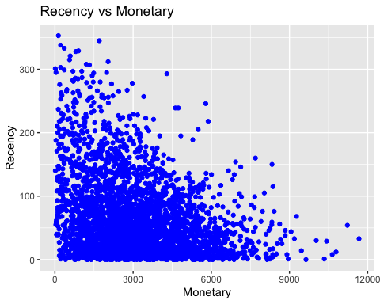
Model Development
Recency vs Monetary Value
Higher revenue would be associated with most recent visits (that is low recency value which implies most recent visits.)

Slide 17
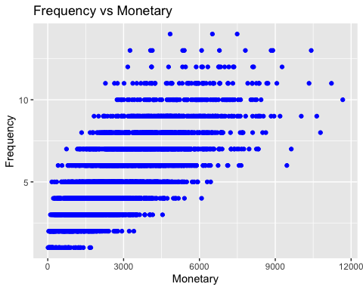
Model Development
Frequency vs Monetary Value
As the frequency of visits increases, the revenue generated also increases.

Slide 18
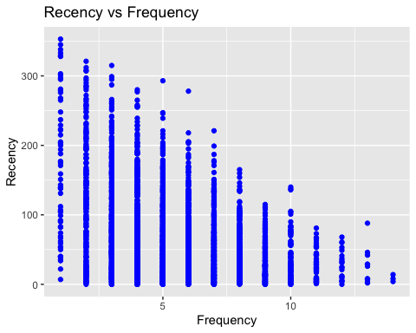
Model Development
Frequency vs Monetary Value
As the frequency of visits increases, the revenue generated also increases.

Slide 19
Interpretation
CUSTOMER CLASSIFICATION – Targeting High Value Customers
The following are the high-value clients to target from the new list :
Aged between 45 – 55.
Most of the high value customers are female compared to male
Working in Financial Service, Manufacturing and Health.
Customers having high RFM scores can be filtered and targeted.

Slide 20
Interpretation
Customer Segment | Activity | Recency Score Range | Frequency Score Range | Monetary Score Range
Champions | Bought recently, buy often and spend the most! | 4-5 | 4-5 | 4-5
Loyal Customers | Spend good money with us often. Responsive to promotions. | 2-5 | 3-5 | 3-5
Potential Loyalist | Recent customers but spent a good amount and bought more than once. | 3-5 | 1-3 | 1-3
Recent Customers | Bought most recently, but not often. | 4-5 | 1-1 | 1-1
Promising | Recent shoppers but haven’t spent much. | 3-4 | 1-1 | 1-1
Customers Needing Attention | Above average recency, frequency and monetary values. May not have bought very recently though. | 2-3 | 2-3 | 2-3
About To Sleep | Below average recency, frequency and monetary values. Will lose them if not reactivated. | 2-3 | 1-2 | 1-2
At Risk | Spent big money and purchased often. But long time ago. Need to bring them back! | 1-2 | 2-5 | 2-5
Can’t Lose Them | Made biggest purchases, and often. But haven’t returned for a long time. | 1-1 | 4-5 | 4-5
Hibernating | Last purchase was long back, low spenders and low number of orders. | 1-2 | 1-2 | 1-2
Lost | Lowest recency, frequency and monetary scores. | 1-2 | 1-2 | 1-2

Slide 21
Thank You

